Slide 1
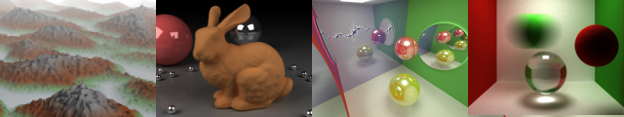
GPU Ray-tracing
Liam Boone
University of Pennsylvania
CIS 565 - Fall 2013
Content adapted from Karl Li’s slides from fall 2012

Slide 2
Outline
Quick introduction and theory review:
The Rendering Equation
Bidirectional reflection distribution functions
Pathtracing algorithm overview
Implementing parallel ray-tracing
Recursion versus iteration
Iterative ray-tracing

Slide 3
The Rendering Equation
Outgoing light
Emitted light
Integrate over a hemisphere
BRDF (more on this later)
Incoming light
Attenuation term between light direction and normal

Slide 4
Bidirectional Reflectance Distribution Functions (BRDFs)
Defines how light is reflected at a given opaque surface
Reflectance models:
Ideal Specular (think mirrors)
Ideal Diffuse
Can be extended with transmittance to produce the BSDF: Bidirectional Scattering Distribution Function
Notes:
4D function
Returns the ratio of reflected radiance exiting along w_r to the irradiance incident on the surface from direction w_i.
w defined in ref. to surface normal

Slide 5
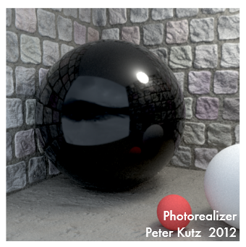
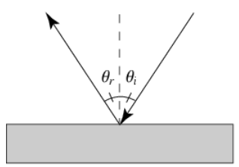
Reflectance Models: Ideal Specular
Incoming light and outgoing light make the same angle across the surface normal, so angle of incidence = angle of reflection

Slide 6
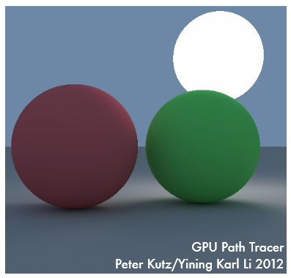
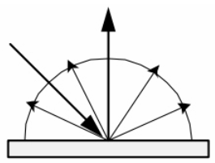
Reflectance Models: Ideal Diffuse
Ideal diffuse reflection: light is equally likely to be reflected in any output direction within a hemisphere oriented along the surface normal over a given point

Slide 7
Path-tracing
Solves the rendering equation, which was first proposed by James Kajiya in 1986
Generalizes ray tracing
Full global illumination
Soft shadows
DOF
Antialiasing
Potenially extremely slow on the CPU

Slide 8
Algorithm
For each pixel, shoot a ray into the scene
For each ray, trace until the ray hits a surface
Sample the emittance and BRDF then send the ray in a new random direction
Continue bouncing each ray until a recursion depth is reached
Repeat steps 1-4 until convergence

Slide 9
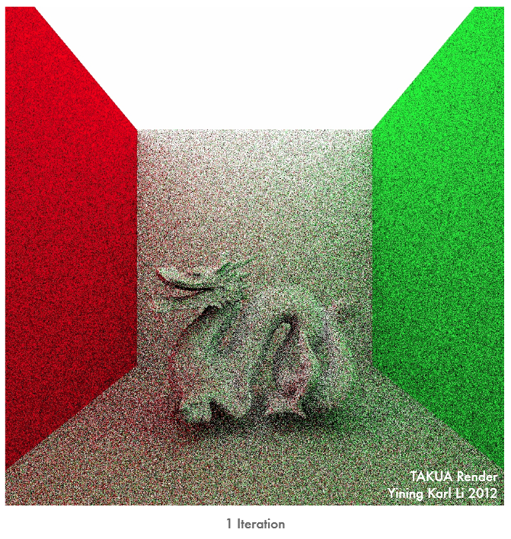

Slide 10
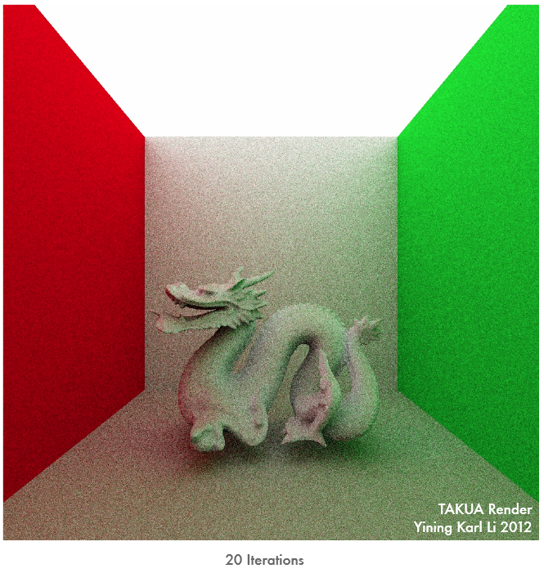

Slide 11


Slide 12
Demos
Peter and Karl’s GPU Path Tracer:
https://vimeo.com/41109177
BRIGADE Renderer:
http://www.youtube.com/watch?v=FJLy-ci-RyY
Octane otoy:
http://render.otoy.com/gallery.php

Slide 13
Basic Ray-tracing Algorithm
For each pixel, shoot a ray into the scene
For each ray, trace until the ray hits a surface
For each intersection, cast a shadow feeler ray to each light source to see if each light source is visible and shade the current pixel accordingly
If the surface is diffuse, stop. If the surface is reflective, shoot a new ray reflected across the normal from the incident ray
Repeat steps 1-4 over and over until a maximum tracing depth has been reached or until the ray hits a light or a diffuse surface

Slide 14
Recursion
rayTrace(int depth, ray r, vector<geom> objects, vector<lights> light_sources)
[find closest intersect object j, normal n, and point p]
color = black
if object j is reflective:
reflected_r = reflect_ray(r, normal, p)
reflected_color = rayTrace(depth+1, reflected_r, objects, light_sources)
color = reflected_Color
for each light l in light_sources:
if shadow_ray(p, l)==true{
light_contribution = calculate_light_contribution(p,l,n,j);
color += light_contribution
return color;

Slide 15
Parallelizing Ray-tracing
An embarrassingly parallel problem
Tracing each pixel in the image is computationally independent from all other pixels
Tracing a single pixel is not a terribly computationally intense task, there’s simply a lot of tracing that needs to happen
Solution: parallelize along pixels
Launch one thread per pixel, trace hundreds to thousands of pixels in mass parallel

Slide 16
One Caveat
CUDA does not support recursion!* *Except on Fermi based cards or newer

Slide 17
Iterative Ray-tracing
Iterative ray-tracing: a slightly less intuitive ray-tracing algorithm that does not need recursion!
Analogy: think breadth first search versus depth first search

Slide 18
Iteration
rayTrace(int depth, ray r, vector<geom> objects, vector<lights> light_sources):
ray currentRay = r
color = black
for i in {1, 2, …, depth}:
[determine closest intersect object j, normal n, point p]
if object j is reflective:
reflected_r = reflect_ray(r, normal, p);
for each light l in light_sources:
if shadow_ray(p, l) == true:
color += color * calculate_light_contribution(p,l,n,j);
return color

Slide 19
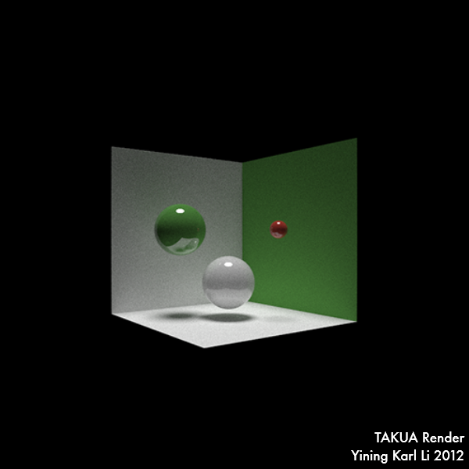
How many bounces per path?
Notes:
How many bounces?

Slide 20
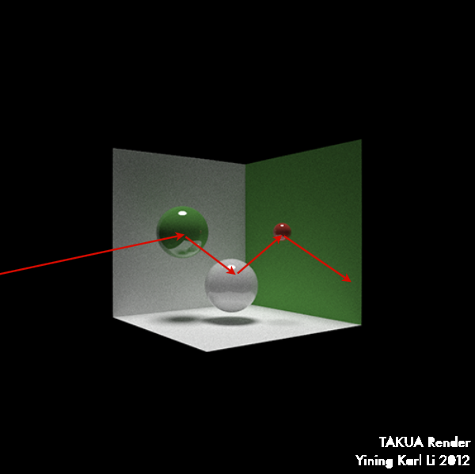
How many bounces per path? 4?

Slide 21
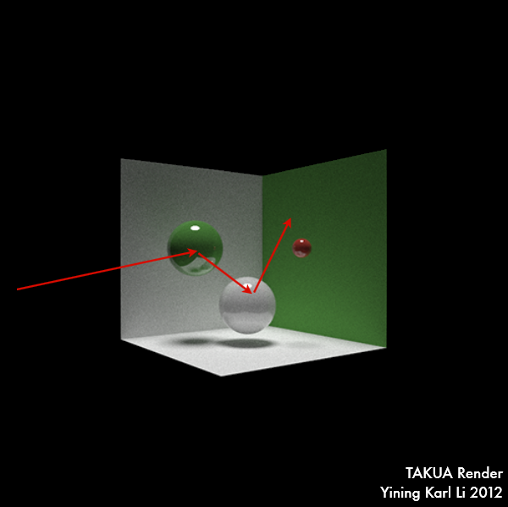
How many bounces per path? 4? 3?

Slide 22

How many bounces per path? 4? 3? 2?

Slide 23
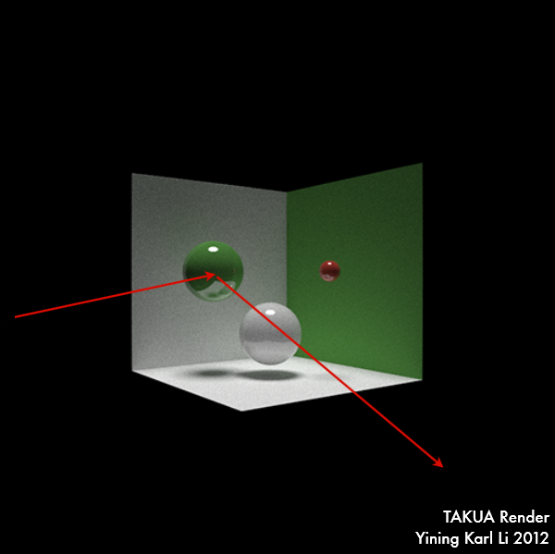
How many bounces per path? 4? 3? 2? 1?

Slide 24

How many bounces per path? 4? 3? 2? 1? 0?

Slide 25
How many bounces per ray?
We have no idea!
What does this imply about parallelizing by pixel?
Notes:
How many bounces?

Slide 26
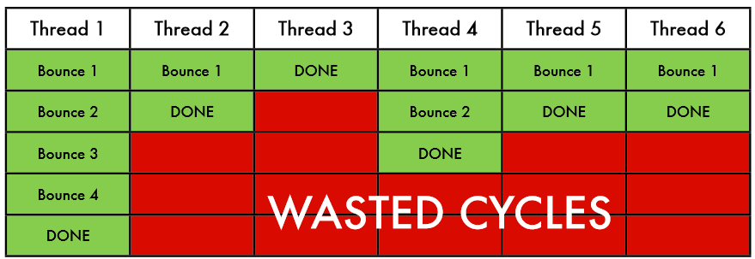
Wasted Cycles
GPU can only handle finite number of blocks at a time
If some threads need to trace more bounces, then others might spend too much time idling

Slide 27
Ray Parallelization
Parallelize by ray, not pixel
Multiple kernel launches that trace individual bounces
Construct pool of rays that need to be tested
Construct accumulator image, initialize black
Launch a kernel to trace ONE bounce
Add any new rays to the pool
Remove terminated rays from the pool
Repeat from 3 until pool is dry

Slide 28
Ray Parallelization
Each iteration will have fewer rays, requiring fewer blocks, and giving faster execution.
Works very well (even in practice)
Be careful of edge cases!

Slide 29
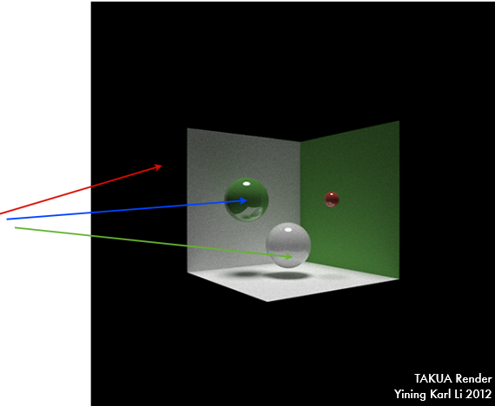
Example
Ray pool:
1, 2, 3
Threads needed:
3
Ray 1 terminates

Slide 30
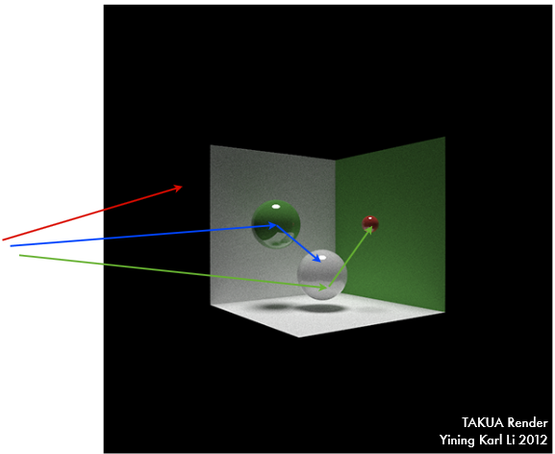
Example
Ray pool:
2, 3
Threads needed:
2

Slide 31

Example
Ray pool:
2, 3
Threads needed:
2
Ray 3 terminates

Slide 32

Example
Ray pool:
2
Threads needed:
1
Ray 2 terminates

Slide 33
Memory Management
What happens in a static scene on the first bounce?

Slide 34
Memory Management
What happens in a static scene on the first bounce?
Many many threads are all trying to access the same places in global memory!
Two solutions:
Cache geometry in shared memory
When would this be bad?
Cache the result of the first bounce and start from there next time

